Slide 2
US Equity performance sharp reaction to tariff

Slide 3
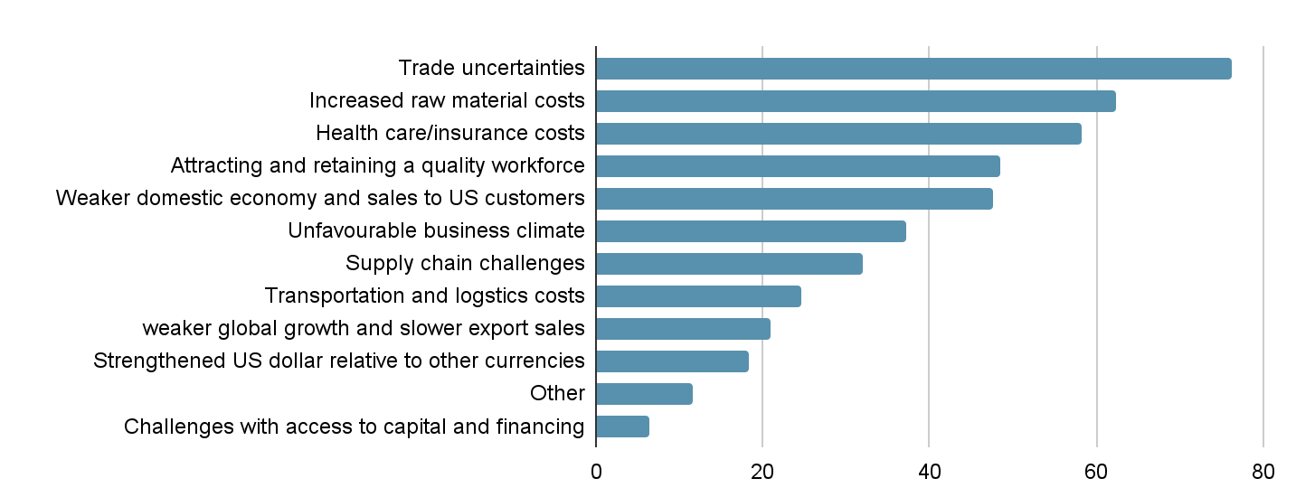
US manufacturers skeptical towards benefitting from tariffs
Skepticism amongst manufacturers on the usefulness of tariffs
Trade uncertainties are now at the top of manufacturers’ concerns
Tariffs are weighing on manufacturers expectation of raw material prices and other input costs, expect costs to increase 5.5% on average, the highest rate of increase since Q2 2022
https://nam.org/wp-content/uploads/securepdfs/2025/03/Q1_2025_Outlook_Survey.pdf
https://fortune.com/2025/04/03/trump-says-tariffs-will-help-manufacturing-why-are-manufacturers-so-furious/

Slide 4
Period 1
Trade uncertainties
76.2
Increased raw material costs
62.3
Health care/insurance costs
58.3
Attracting and retaining a quality workforce
48.4
Weaker domestic economy and sales to US customers
47.6
Unfavourable business climate
37.3
Supply chain challenges
32.1
Transportation and logstics costs
24.6
weaker global growth and slower export sales
21
Strengthened US dollar relative to other currencies
18.3
Other
11.5
Challenges with access to capital and financing
6.4

Slide 5
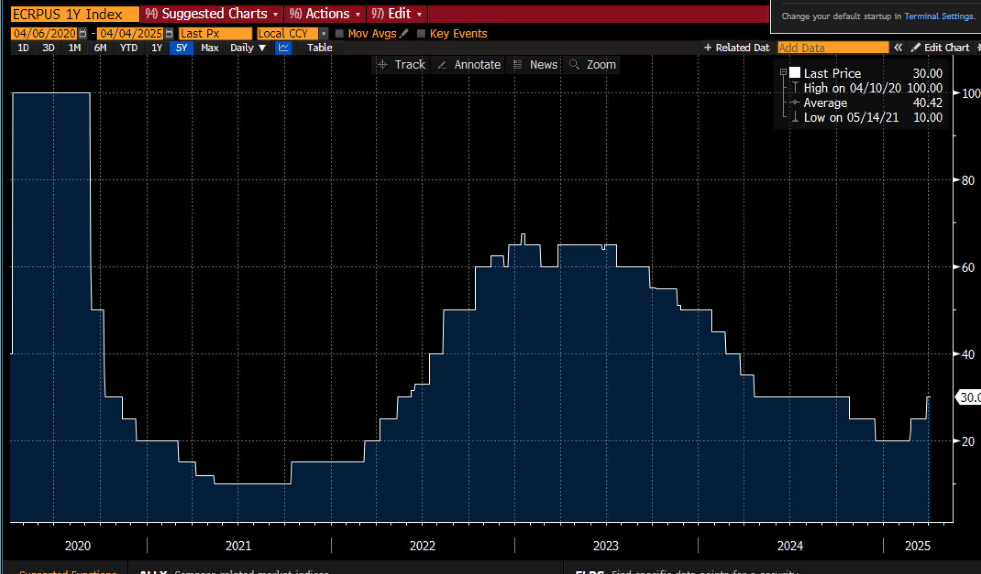
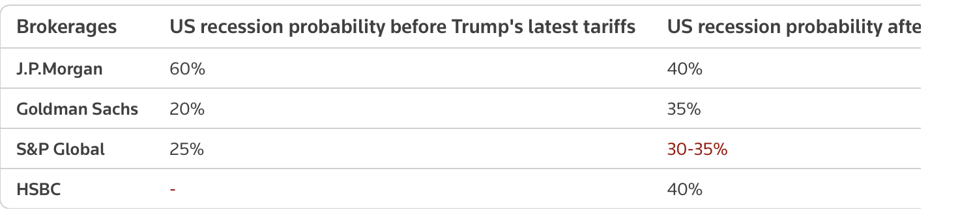
Estimated ~40% probability of US recession
https://fortune.com/2025/04/04/trump-tariffs-jpmorgan-raises-recession-risk-amid-global-market-rout/
Bank economists estimate that the tariffs increases will cause US household $700bn, due to rising import costs
RATE-CUT HOPES
While tariffs could stifle economic growth, some analysts expect this could give more room for the U.S. Federal Reserve to cut interest
The effect ... is likely to be magnified through (tariff) retaliation, a slide in U.S. business sentiment and supply-chain disruptions. rates further in order to boost economic activity.
"The pinch from higher prices that we expect in coming months may hit harder than in the post-pandemic inflation spike, as nominal income growth has been moderating recently, as opposed to accelerating in the earlier episode," Feroli added.

Slide 6
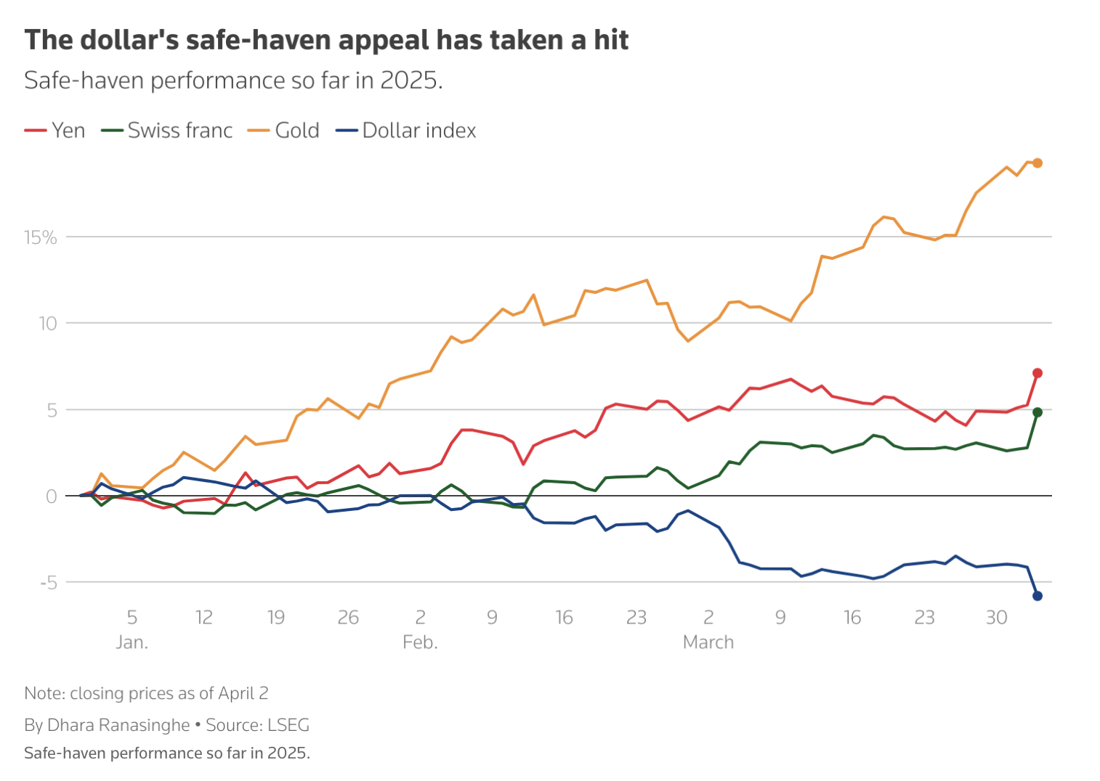
Doll
The dollar, one of the world's safest places to park money in times of turmoil, has been shunned by investors as an option for now as uncertainty over tariffs and concern over their impact on U.S. growth intensify.
Swiss franc, gold, yen
While the dollar typically rallies when the S&P 500 stock index falls (.SPX)
, opens new tab
, both have fallen recently, in a sign the greenback is not benefiting from safe-haven flows.

Slide 7
Fixed income
U.S. 10-year Treasury yields, down more than 10 basis points on Wednesday alone, are on track for their biggest weekly drop in five weeks .
For sure though, not all of that has been driven purely by a bid for safety. Tariff worries have also raised recession risks and the chances of further global interest rate cuts - a backdrop that typically benefits bonds.
Renewed tariff anxiety, for now at least, alleviates selling pressure in government bonds that typically benefit from safe-haven flows amid global stress.
Germany's benchmark 10-year Bund yield, which has risen on expectations that a surge in German spending will increase bond sales, has fallen from almost five-month highs hit last month .

Slide 8
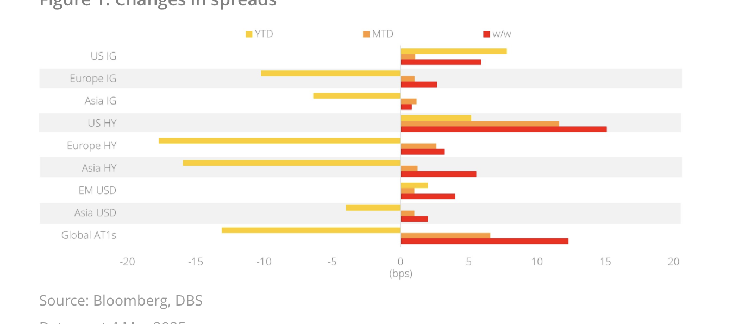
Credit
https://www.dbs.com/in/treasures/aics/investment-strategy/templatedata/article/generic/data/en/CIO/032025/250306FixedIncomeWeekly.xml

